Slide 1

Adventure Works
Present by
Group-6
K. Yuva Karthik
K. Krishna
Keerthi durgam
CH. Akhila
Rajat
Akshay Pawar

Slide 2
Data Overview
The dataset we analyzed provides information about Adventure Works' operations and performance. It includes the following key components:
Sales Performance Data:
Detailed records of total sales, profit, and production costs, helping us measure the company’s financial success.
Customer Demographics:
Information about the customer base, which helps us identify target groups and tailor strategies accordingly.
Product Categories and Subcategories:
Insights into the performance of different product lines, highlighting bestsellers and areas for potential growth.
Sales Region Details:
Data on regional sales performance, helping us identify top-performing regions and untapped markets.
Time-based Sales Data:
Yearly, quarterly, and monthly sales trends, enabling us to pinpoint peak seasons and forecast future demand.

Slide 3
Key Performance Indicator(KPI)
Total Sales and Profitability:
Adventure Works achieved total sales of $29.36M, with a profit of $20.36M, and a production cost of $9.00M. The total order quantity was 60,398, highlighting strong products demand.
Year-wise Sales:
The year 2013 was the most successful year, generating $16.35M in total sales.
Top Product:
Highlight Mountain Bikes-200 (Black/Silver) as the most profitable product driving significant revenue.
Month-wise Sales:
Sales followed a steady upward trend as the year progressed, with December recording the highest sales figures.
Regional Performance:
The United States and Australia were the most profitable regions, achieving sales of $9.39M and $9.06M, respectively. These regions were key drivers of overall growth.

Slide 4
Do's to Improve Business
Focus on Best-Selling Products:
Make more of popular products like Mountain-200 to meet high demand.
Invest in Key Regions:
Put more effort into growing sales in important places like Australia and the US.
Improve Marketing:
Run ads during busy shopping times, especially in Quarter 4 and December.
Manage Stock Well:
Make sure you have enough products in stock during busy sales months.
Use Data to Save Costs:
Look at sales and production costs to find ways to save money and work more efficiently.
Know Your Customers:
Create products and ads that fit the needs of customers in different age groups and income levels.

Slide 5
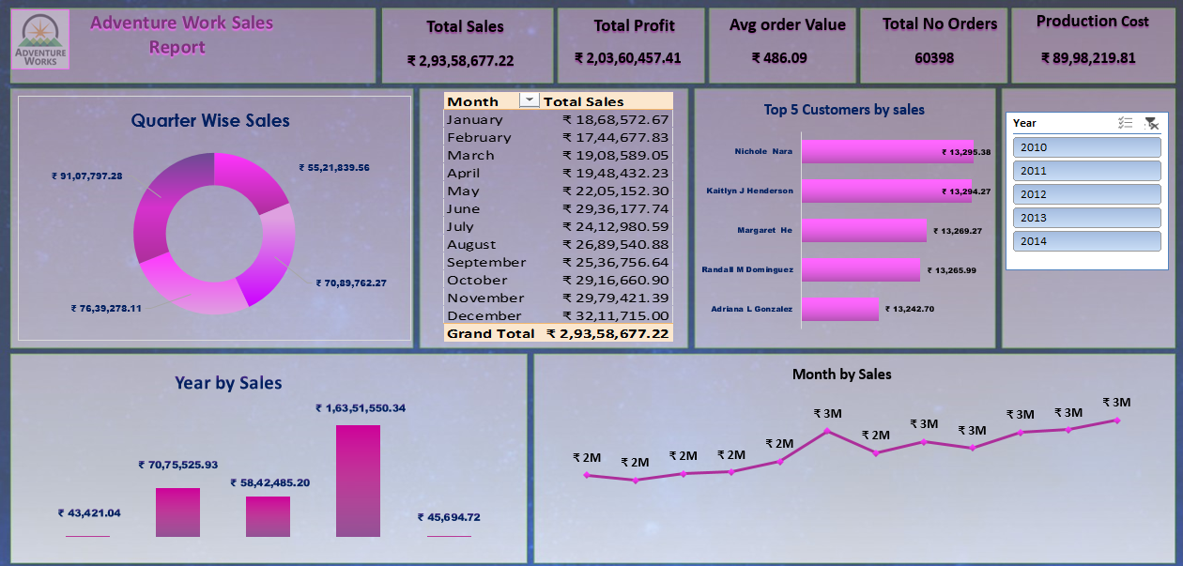

Slide 6
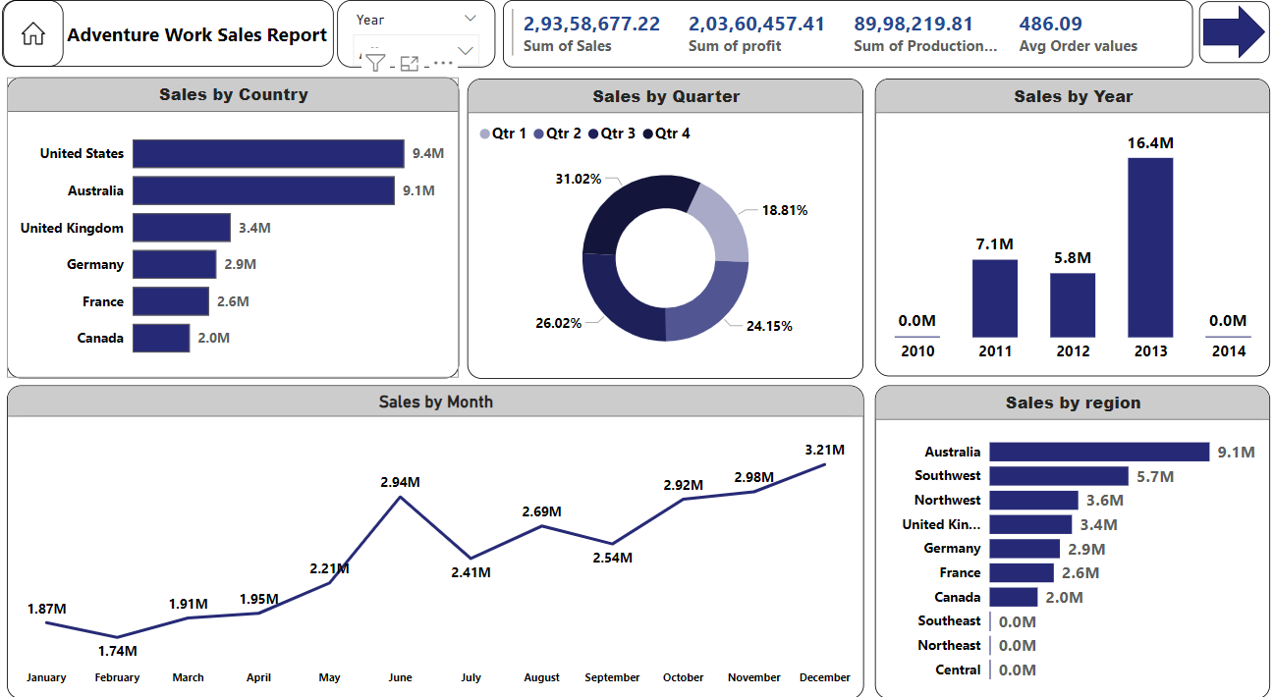

Slide 7
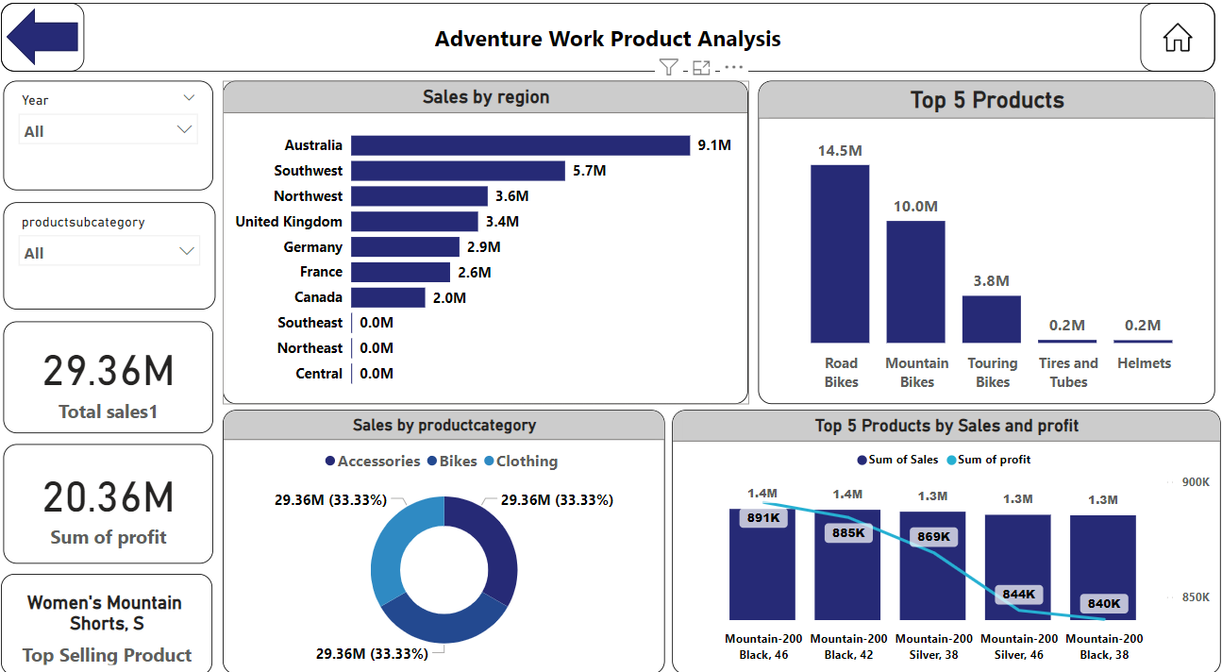

Slide 8
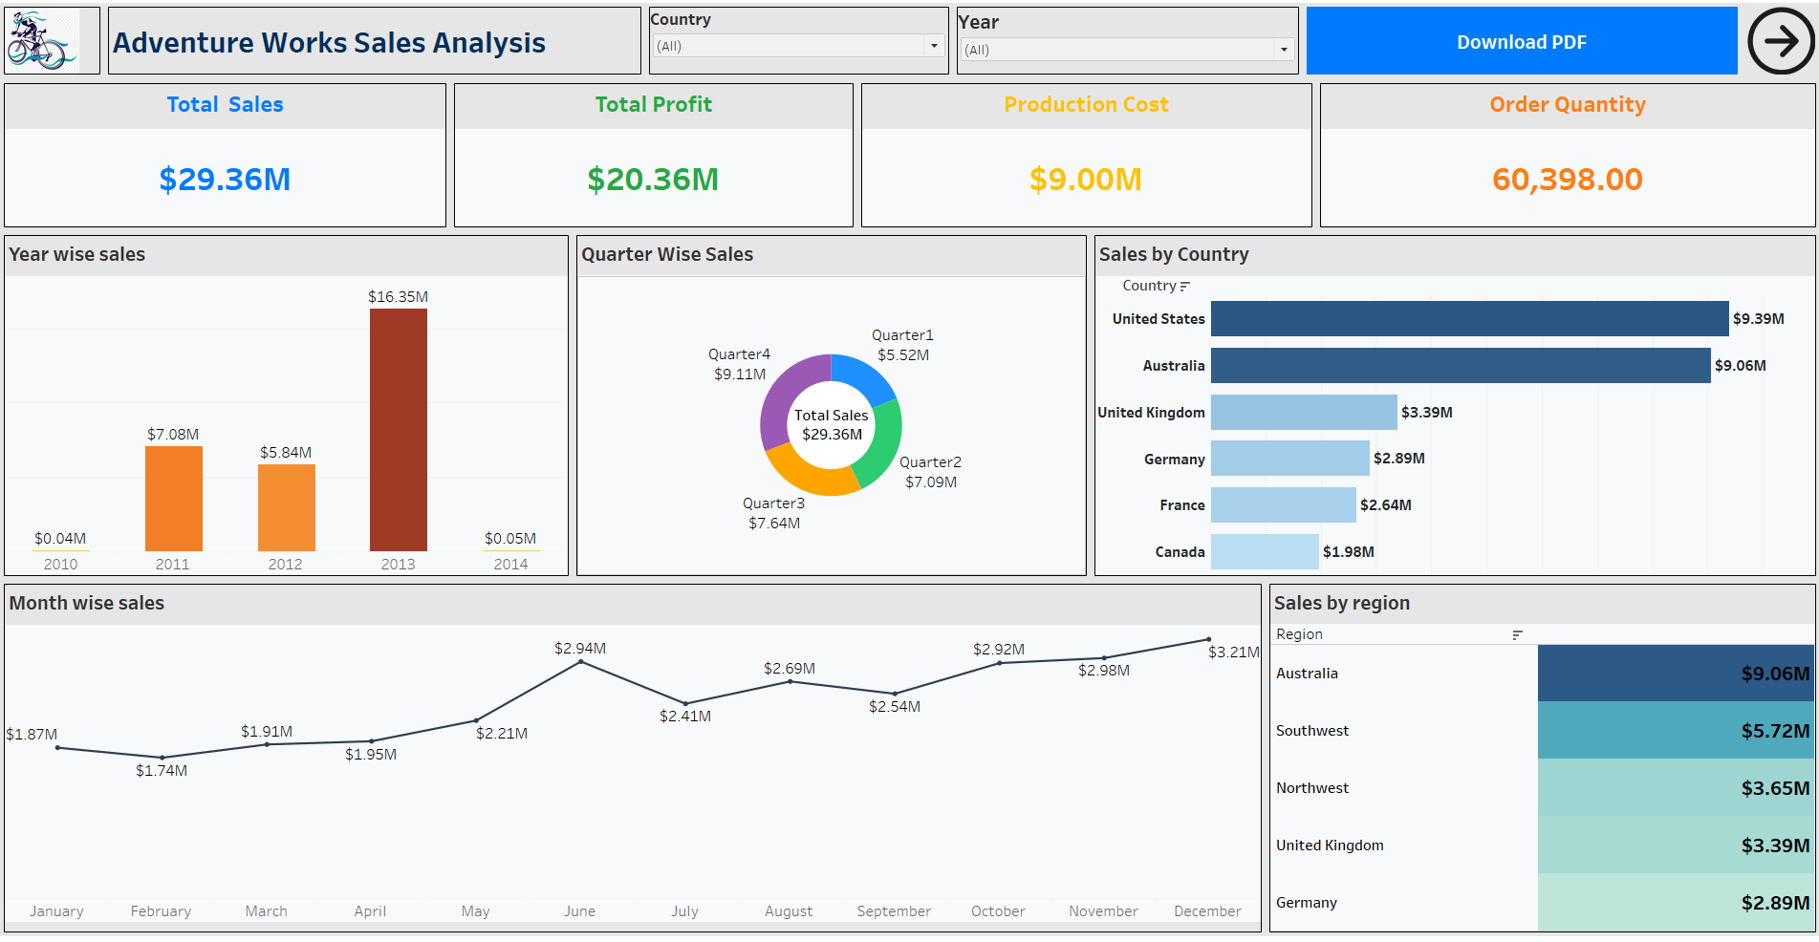

Slide 9
Conclusion
In summary, the analysis highlights Adventure Works' strengths in seasonal sales, regional performance, and product success.
By focusing on key recommendations like targeting top regions, leveraging seasonal demand, and expanding high-performing product lines, the company can achieve sustained growth and profitability.

Slide 10
THANK YOU For Your Time

